Slide 1
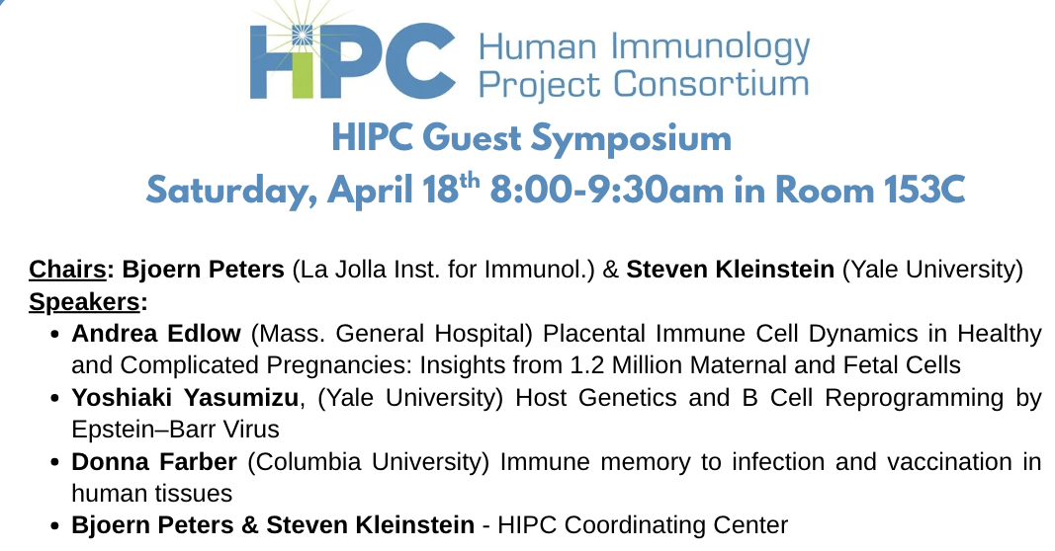



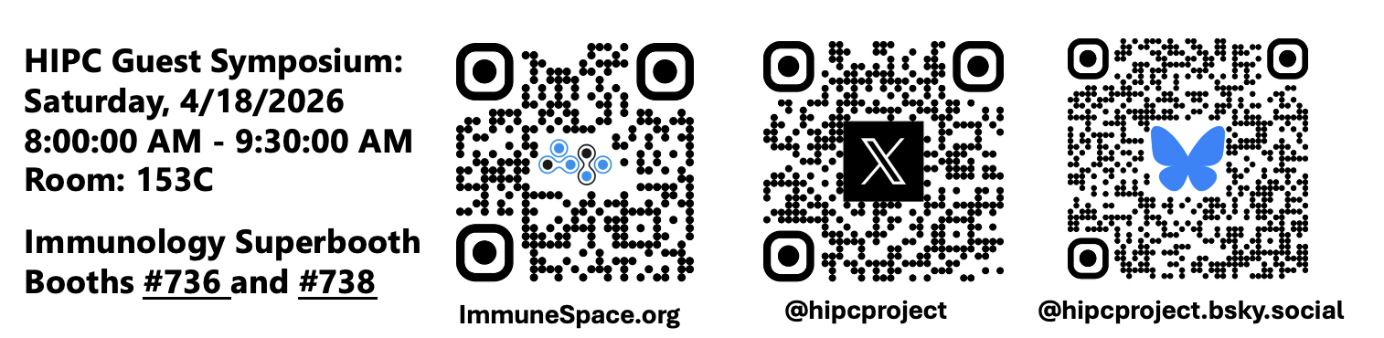


Immunology Superbooth
For updates throughout the week follow our Twitter/X and Bluesky accounts.
Featuring 4 NIH-funded resources!
IEDB
CEDAR
AKC
Booth #736 & #738
ImmuneSpace

Slide 2
[Add a slide to your presentations]

